Slide 1
Rockbuster Stealth
Nicole Chiu

Slide 2

Objective & key questions
Analyze the data to inform launch strategy for new online video service
What was the average rental duration for all videos?
Which movies contributed the most/least to revenue gain?
Which countries are Rockbuster customers based in?
Where are customers with a high lifetime value based?
Do sales figures vary between geographic regions?

Slide 3
Goals for today’s presentation
Understand how revenue is generated from the current movie selection and worldwide impact of Rockbuster Stealth to inform the launch of new online streaming services

Slide 4
Revenue analysis of rockbuster’s movie selection

Slide 5
Movie & Rental Overview
Minimums & Maximums
Movie length
185min
46min
Rental duration
7 days
3 days
Rental rate
$4.99
$0.99
Replacement Cost
$29.99
$9.99
No outliers present. Video rental rates fell into one of three buckets: $0.99, $2.99, or $4.99.

Slide 6
5 days
Average Rental Duration
Recommendation:
If pursuing pay-per-view payment model, configure film availability for customer for 5 days globally
If pursuing subscription-based payment model, consider further analysis to determine turnover of film availability
What was the average rental duration for all videos?

Slide 7
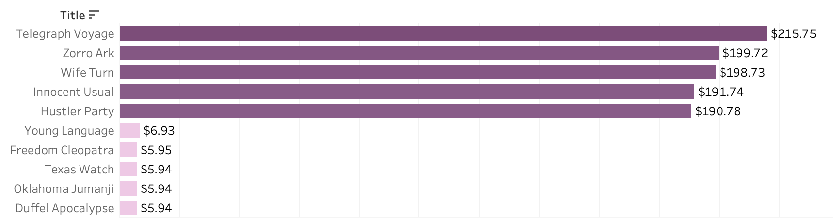
Revenue Gain by Movie: Top & Bottom 5
Customers had 958 total movies to choose from.
Around one third of those movies (the top 300 movies) made up 54% of the revenue gains from payments made in stores in 2007.

Slide 8
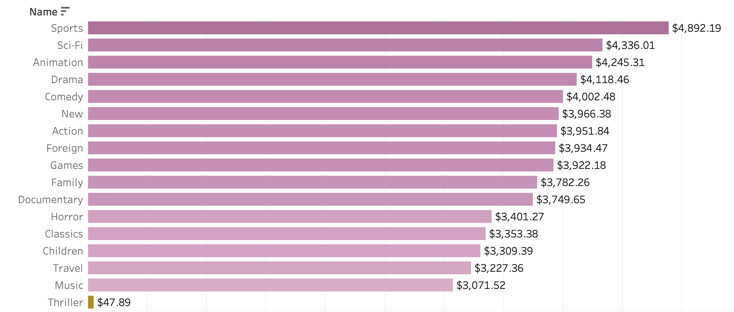
Revenue Gain by Genre
A more helpful analysis is analyzing revenue gain by genre. Of 17 genres, the top three genres that generated the most revenue are: Sports, Sci-Fi, and Animation.

Slide 9
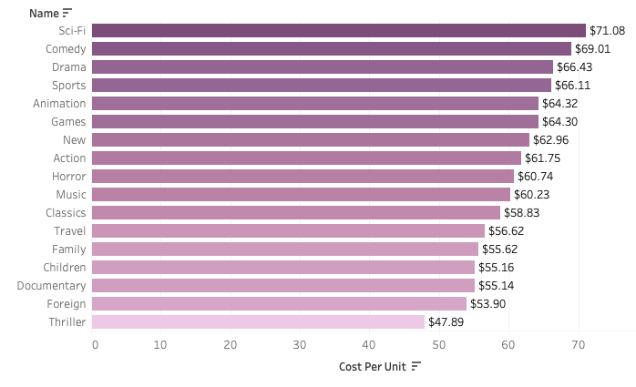
Revenue Gain by Film Unit Genre
Still more helpful is to understand how many films of each genre were available for rental and analyze the amount of revenue one film in each genre was generating.

Slide 10
Revenue Gain by Genre
While Sports, Sci-Fi, and Animation were the top earning genres, there was only one Thriller title available at the rate of $2.99 which explains the low revenue gain in the previous slide.
Consider further analysis around the Thriller genre
Since there are a certain number of titles available per genre, the top genres when analyzing revenue per film genre are: Sci-Fi, Comedy, and Drama.
Consider offering more titles of genres that bring in $60+/film
Further analysis required to understand customer genre spending habits by geography

Slide 11
Worldwide impact of rockbuster stealth

Slide 12
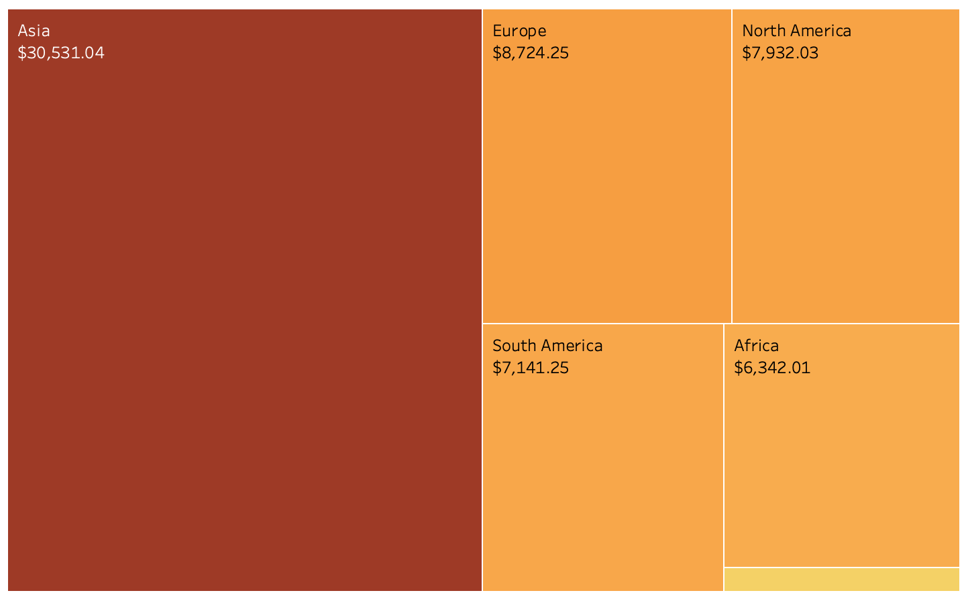
Revenue by Geographic Region
Asia leads in sales, with sales figures that are 3.5x more than Europe, the second geographic region with the most revenue.

Slide 13
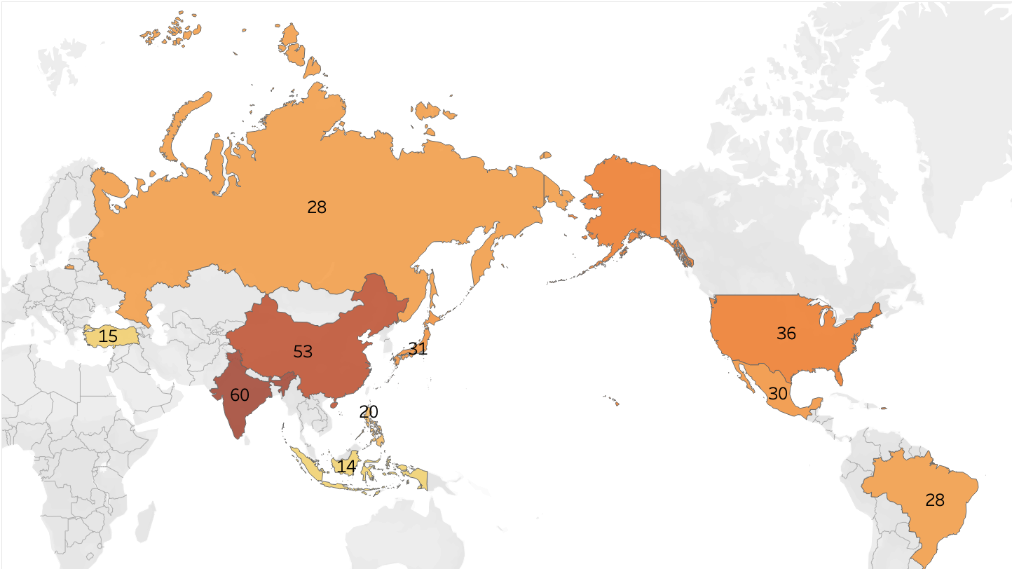
Top 10 countries with the highest number of rockbuster customers
Top 3: India, China, and the United States

Slide 14
Customers: Digging deeper
When examining the revenue by geographic region and the top 10 countries with the highest number of customers, it becomes apparent that the Philippines, Brazil, and the United States spend the most on rentals per customer
Recommendation: Target online ads and pilot streaming services with these top 3 countries before global roll out
Country | Count of Customers | Total Revenue | Revenue per Customer
Philippines | 20 | $2,220 | $111
Brazil | 28 | $2,920 | $104
United States | 36 | $3,694 | $103
Japan | 31 | $3,122 | $101
India | 60 | $6,033 | $101

Slide 15
Customers: Digging deeper
Which cities within the top countries have highest number of customers?
Where are lifetime customers?
Customer ID | City | Country | Total Paid
225 | Ambattur | India | $112
424 | Shanwei | China | $110
240 | Iwaki | Japan | $107
486 | Acua | Mexico | $101
537 | Aurora | US | $99
City | Country | Count
Aurora | United States | 2
Acua | Mexico | 1
Citrus Heights | United States | 1
Iwaki | Japan | 1
Ambattur | India | 1
2/5 of the top cities are in the United States, and lifetime customers are found in Asia and North America. This is in line with the previous slide, with the highest number of customers residing in India, China, and the United States.
Where are customers with a high lifetime value based?

Slide 16
Recommendations
Maintain and increase number of movie licenses for Sci-Fi, Comedy and Drama genre movies and launch streaming services with these genres highlighted in the Philippines, Brazil, and the United States
Focus marketing and streaming membership services in the Philippines, Brazil, and the United States before global roll out
Consider further analysis (next slide)

Slide 17
Further analysis
The payment data is from 2007 and rental dates span 2005-2006. It would be important to do further analysis on more current data if possible, as the launch date for online streaming services is in 2020
This data is based on physical rentals, meaning films rented from a store. Further analysis on competitor streaming data is necessary.
For example, recent data shows that more than half of Netflix’s subscribers are in Europe, the Middle East, and Africa
Further analysis of “bingeable” TV series data can lead to including in launch and boost revenue
Notes:
https://nypost.com/2019/12/18/netflix-data-reveals-how-foreign-markets-are-fueling-its-growth/

Slide 18




Thank you
Nicole Chiu
nchiu8@gmail.com
Visualizations

